Slide 1
A Journey Through Ruby Concurrency
RubyConf Brasil 2016
@jerrydantonio

Slide 2


Notes:
I’d like to start by saying Thank You to Locaweb.
Locaweb sponsored my travel visa, assisted me with all my travel arrangements, and helped me through the visa process.
They are tremendous people who have gone out of their way to assist me with this visit.
It’s fair to say that without Locaweb I would not be here.
So please give a big round of applause to Locaweb!

Slide 3


Jerry D’Antonio
Akron, Ohio, USA
Software Developer
Test Double
@jerrydantonio
github.com/jdantonio
concurrent-ruby.com
Notes:
My name is Jerry D’Antonio
I am from Akron, Ohio, USA
I am a Software Developer at Test Double, a consulting agency based in Columbus, Ohio.
I am @jerrydantonio on Twitter
And jdantonio at GitHub
Most importantly, with respect to this presentation, I created Concurrent Ruby.
The Concurrent Ruby gem is a suite of concurrency tools used by many well-known projects including Rails, Sidekiq, Sucker Punch, and Microsoft’s Azure tools for Ruby.

Slide 4

Notes:
You may have heard of Akron, Ohio.
There’s a local kid who you may have heard of.
He’s a pretty good basketball player.
His name is LeBron James.
So I am definitely NOT the most famous person from Akron, Ohio.
Not even close. :-)

Slide 5
Let’s get started.
Notes:
But we aren’t here to talk about basketball. We’re here to talk about Ruby concurrency.

Slide 6
A few weeks ago Koichi Sasada, aka ko1, proposed a new concurrency model for Ruby 3.

Slide 7

And now everyone is talking about concurrency.
Even more than usual.
Including me.
Especially me.

Slide 8
Which is good. It’s an important topic, and critical to Ruby’s future.

Slide 9
But we need to have the right conversations.

Slide 10


When discussing Ruby concurrency I frequently hear people say wrong things.
Notes:
People say things like:
“Ruby should do what Erlang does.”
Or “Ruby should do what Node.js does.”
Or “Ruby should do what Go does.”
Or “Ruby should do what… some other language does.”

Slide 11


Slide 12
Although well meaning, comments like this can sometimes be unhelpful.

Slide 13
Ruby can’t necessarily do what Erlang does, or what Node does, or what language X does.
Nor should it.

Slide 14
Because Ruby isn’t Erlang or JavaScript or any other language.

Slide 15

Ruby is Ruby

Slide 16
Ruby is designed to solve different problems.

Slide 17
Ruby has a different runtime,
different philosophies,
and different characteristics.
Notes:
Ruby isn’t being used to build telephony systems.
Ruby isn’t being used to build large-scale chat systems.
Ruby isn’t being used for systems programming.
And that’s OK.
Ruby solves some problems very well, and those are the types of applications Ruby is used for.

Slide 18

Notes:
I love Ruby.

Slide 19

makes me
Notes:
Ruby makes me happy.
Ruby makes many, many developers happy.
We know this because there are 1300 people here, today, who love Ruby.

Slide 20
Although Ruby can—and should—take inspiration from other languages.
Ruby must embrace Ruby.
Notes:
Ruby must embrace the things about Ruby that we love.
Ruby must embrace the things about Ruby that make us happy.

Slide 21
So, with respect to concurrency, what are Ruby’s most important characteristics?
Notes:
What are the things that we, Ruby developers, must consider when writing concurrent applications?
What are the things that we, the Concurrent Ruby team, must think about when designing concurrency tools?
What are the things the Ruby core team needed to think about when designing the concurrency model for Ruby 3?

Slide 22
Ruby is…
Shared memory
Reference-based
Object oriented

Slide 23
Everything in Ruby is an object.

Slide 24
Ruby has no value types, no true primitives.

Slide 25
Even booleans, symbols, and integers are objects.

Slide 26
As most of you know…
Variables are not values.
Variables are references to values.
References point to memory locations on the heap.

Slide 27
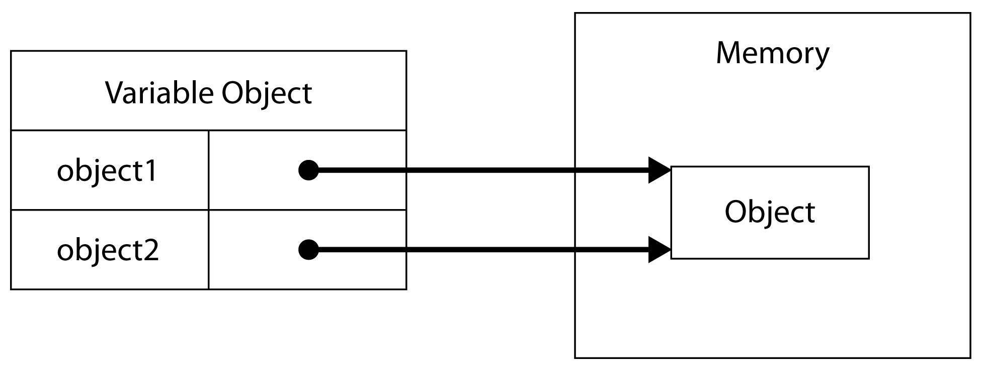
Notes:
Strictly speaking, Ruby is a call by sharing language.
Pass an object reference to a method and the reference gets copied.
The object does not.

Slide 28
Objects can be modified from within a method by following the reference.
And this behavior exists when we pass variables across thread boundaries.
Notes:
Strictly speaking, Ruby is a call by sharing language.
Pass an object reference to a method and the reference gets copied.
The object does not.

Slide 29
So two or more threads can each have references to the same object, located in the same memory on the heap.
Which means that, in theory, two threads on two processor cores can attempt to simultaneously modify the same memory.

Slide 30

Notes:
And when we do that, bad things happen.

Slide 31
Not on MRI, of course, because it only uses one core and it has a global interpreter lock (GIL).
But that’s sort of a problem, too.
Notes:
This model provides safety when writing concurrent applications, but it has serious implications.
I’m not going to talk about this because there are plenty of blog posts and conference talks about the global interpreter lock.
Including my talk from last year’s RubyConf USA, called “Everything You Know About the GIL is Wrong.”

Slide 32
Shared memory, reference-based, object oriented languages offer many advantages.
Notes:
Which is why they are so popular.

Slide 33
But they aren’t great for concurrency.

Slide 34
Full parallelism with shared-memory, reference-based languages can be very fast and efficient, but is also very difficult to get right.
Locking is hard.

Slide 35
Shared memory, reference-based languages:
Ruby
Python
C, C++
Java
C#
Go
Notes:
Shared memory, reference-based languages include:
…
And many others.
Basically, most of today’s dominant programming languages.

Slide 36
Functional languages like Erlang, Clojure, and Haskell are generally considered better for concurrency.

Slide 37
But they are very different languages.

Slide 38
They favor values over references,
enforce immutability,
and in some cases offer memory isolation.

Slide 39
Erlang, for example...
Has only values, not references.
Has only immutable variables.
Has a very small set of value types.
And enforces strict memory isolation.

Slide 40
This is all very good for concurrency.
But isn't necessarily all good.
Or necessarily better.

Slide 41

!=
Notes:
Ruby and Erlang are very different languages.

Slide 42
=/=
Notes:
This one is for the Erlangers in the audience.

Slide 43

Functional languages like Erlang require different paradigms and patterns, but also pose different challenges.
Notes:
That's OK. This isn’t necessarily good nor is it necessarily bad.
It’s just different.

Slide 44
Some people like programming in functional languages.

Slide 45
I’ve worked professionally with functional languages and I’m quite fond of them.
Notes:
I even created a gem called functional-ruby where I experiment with other stuff.

Slide 46
Notes:
But I love Ruby.
And so do many, many programmers.

Slide 47
Ruby cannot have the same concurrency model as most functional languages without becoming a very different language.
Notes:
Repeat this.

Slide 48
This is a very critical point.
Notes:
We want Ruby to keep being Ruby.

Slide 49
Ruby simply cannot copy what Erlang, Clojure, or Haskell does without ceasing to be Ruby.

Slide 50
So what do we do?
And by “we” I mean the Concurrent Ruby team.
Because we’ve been working on this problem for several years.

Slide 51
Notes:
So let’s talk about Concurrent Ruby.

Slide 52
We create concurrency abstractions that...
Encourage proven designs.
Provide the strongest possible guarantees.
And embrace the Ruby language.
Notes:
Here's what we do:

Slide 53

Notes:
So how do we do that?

Slide 54
We do three things…

Slide 55


Slide 56
Concurrent Ruby takes its inspiration from other languages.

Slide 57
We leverage ideas from Erlang, Clojure, Java, JavaScript, and other languages.
As well as from academic research.

Slide 58
We don't reinvent the wheel, or try to outsmart the experts.
Notes:
Even though several members of the team are recognized experts.

Slide 59
We create abstractions which enable Ruby programmers to easily implement those proven patterns and practices.

Slide 60
And when programmers follow the guidelines for what we provide, they create safe concurrent systems.

Slide 61


Slide 62
Concurrent Ruby provides the strongest possible thread safety guarantees.
Emphasis on the word “possible.”

Slide 63
We can’t provide stronger guarantees than what the runtime provides.
No concurrency library can.
We use the runtime, we don’t replace it.

Slide 64
Unfortunately, Ruby does not have a formal memory model.
Notes:
For those not familiar with the term memory model:
"A memory model describes the interactions of threads through memory and their shared use of the data." – Wikipedia
Basically, this is a formal definition of much of what we are talking about today.

Slide 65
So we do the best we can with what we have.
Notes:
We optimize our internals for each of the three major runtimes.
We guarantee that our abstractions are free from deadlocks, race conditions, and other concurrency errors.
And we guarantee that our abstractions are thread safe.

Slide 66
What we cannot guarantee is that your code will be thread safe and free from errors.
Notes:
What we cannot guarantee is that your code will be thread safe and free from errors.
No Ruby concurrency library can.
Honestly, most languages can't.
There are many, many ways to make mistakes when creating concurrent systems.

Slide 67

Notes:
Concurrency is hard. We can make it easier, but we cannot necessarily make it easy.

Slide 68
We can only guarantee that if you follow the guidelines and use our tools the way they were intended that you'll probably be OK.

Slide 69
Which is the only guarantee any concurrency library can give you.

Slide 70

Notes:
The last, and possibly most important thing we do, is to embrace the Ruby language.

Slide 71

Notes:
We love Ruby. So we put this love into everything we build.

Slide 72
Even though we take inspiration from other languages, we don't directly copy them.

Slide 73
Instead, we interpret them in a uniquely Ruby way.

Slide 74
optimized for programmer
Notes:
Ruby is optimized for programmer happiness.

Slide 75
optimized for Rubyist
Notes:
So we try to optimize for Rubyist happiness.

Slide 76

And I think we do a pretty good job.

Slide 77

Notes:
But what about Ruby 3?

Slide 78
A concurrency model called “guilds” was recently proposed.
Notes:
As I mentioned earlier.

Slide 79
The core ideas are well-formed and will likely be the basis for concurrency in the next major version of Ruby.
Notes:
The work has only been experimental. It is in the very earliest stages.
So many details still need worked out.

Slide 80
Not surprisingly, it does pretty much everything we've talked about so far.
But it does it in the language itself.

Slide 81
Quite simply, guilds...
Encourage proven designs.
Provide the strongest possible guarantees.
Embrace the Ruby language.
Notes:
Sound familiar?

Slide 82
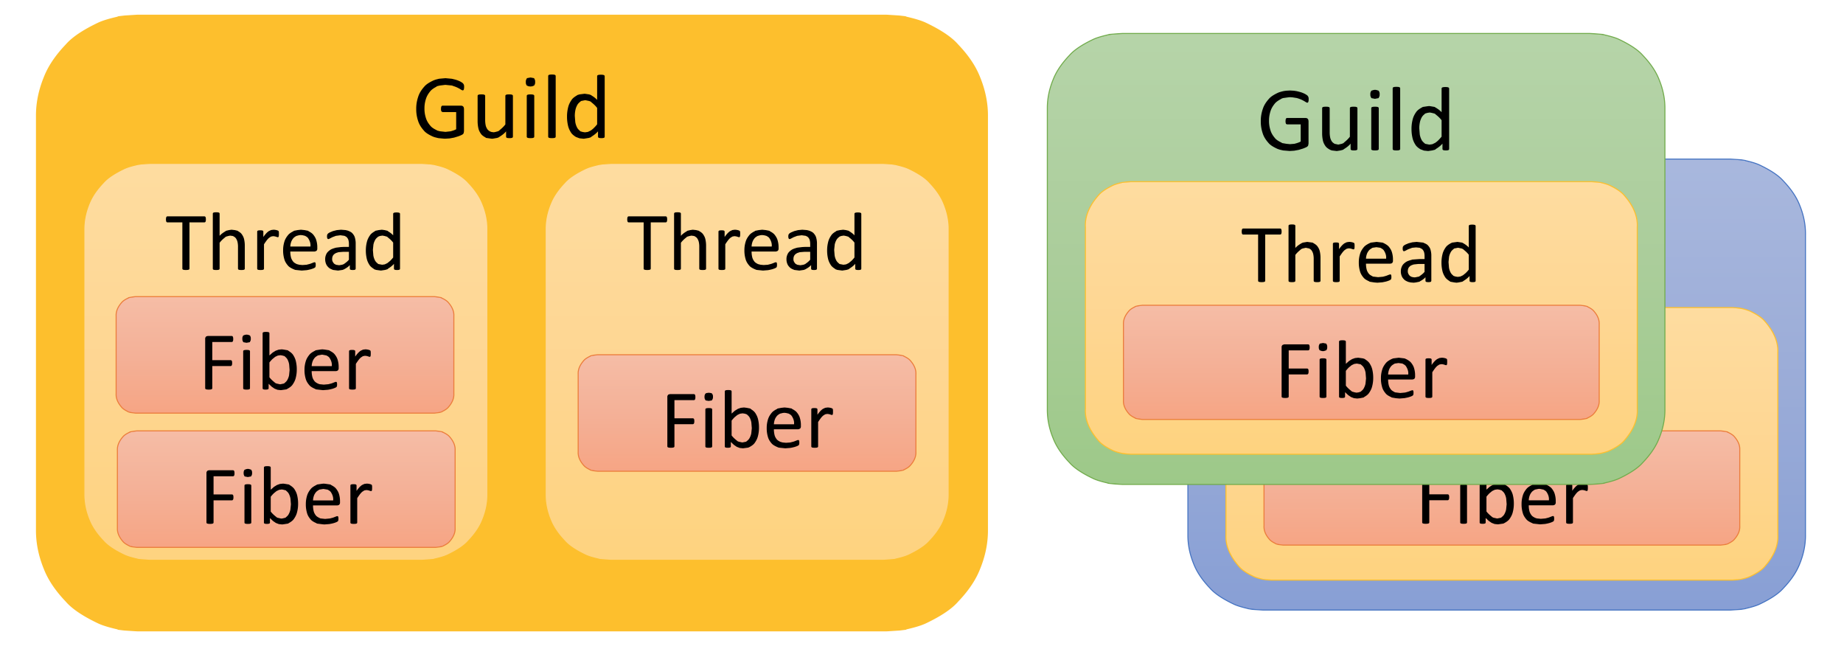
* Image totally stolen from ko1’s presentation. Thank you!
Notes:
The core idea is highly influenced by Erlang, with a little inspiration from Go and Rust.
Every guild has at least one thread.
Every thread has at least one fiber.
And every program has at least one guild.

Slide 83
Like Erlang, guilds are isolated from one another.
Guilds cannot access references which are members of other guilds.

Slide 84
Guilds communicate exclusively through channels.
Channels are one-way, and each guild has one implicit channel.
References are passed between guilds through a channel.
Notes:
The channel is pretty similar to an Erlang mailbox but without all the distributed systems overhead.
So it's also similar to a Go channel, except that it's implicit to the guild.
When we send a message what we really do is transfer a reference between guilds.
The semantics of channel operations are far closer to true message passing than anything Ruby has had previously.

Slide 85
References can be passed two ways: deep copy or membership transfer.

Slide 86
Deep copy is similar to what functional languages do.
Deep copy can be expensive, and with complex objects can lead to odd situations.
Notes:
Remember, functional languages generally have value types, not object references.
The other things we can do is transfer guild membership.

Slide 87
When we transfer membership the object reference is invalidated in the sending guild.
The object now belongs solely and fully to the receiving guild.
Notes:
The other things we can do is transfer guild membership.
This is loosely inspired by Rust’s ownership model (but only very loosely).
In this case we pass the reference, but we copy nothing.
This is true message passing. And it's entirely thread safe.

Slide 88



Notes:
So what will happen to Concurrent Ruby when Ruby 3 arrives?

Slide 89

Nothing changes. We’ll just get harder, better, faster, stronger.

Slide 90
Guilds are a language-level concurrency model, not a high level abstraction.
Notes:
Guilds are more like an Erlang process or a Golang goroutine than an Actor, Promise, Future, Task, etc.

Slide 91
Guilds provide a thread-safe, one-way communication mechanism between isolated threads of execution.
That’s it.

Slide 92
This is very important. Critically important. But it’s not enough for most programmers.

Slide 93
Guilds still require much work to be done by the application programmer.

Slide 94
Programmers must:
Design the interactions between guilds
Handle message receipt, probably in a loop.
Setup two-way communication for transferring results.
Handle exceptions
Communicate errors.
Notes:
Programmers must do a number of things when writing concurrent applications.
…
Remember, Ruby is optimized for programmer happiness.
Doing all of these things every time I want to create a new guild doesn’t feel like a happy path to me.

Slide 95
This is why most “concurrent” programming languages provide high-level abstractions in the standard library.

Slide 96
Erlang has gen_server, gen_event, gen_fsm, and supervisor.
Elixir has Agent and Task.
Scala has Akka.
And there are many other examples.

Slide 97
Notes:
These things, and more, are already provided by Concurrent Ruby.

Slide 98
Guilds do not replace concurrency libraries like Concurrent Ruby.
Guilds give us better tools to build these libraries with.

Slide 99

Notes:
So what about you, the Ruby programmer? What should you do?

Slide 100
You want to build concurrent applications now.
But you also want to be prepared for Ruby 3.

Slide 101
Notes:
Simple. Use Concurrent Ruby. Or use any other high quality concurrency library.
Let us handle the Ruby 3 upgrade for you.
Once Ruby 3 becomes available we will update our internals to take advantage of the new concurrency features—guilds, channels, and message passing.
Our high-level abstractions will still work.
Your applications written today will still work.

Slide 102
“So, Jerry, what do you think about guilds in Ruby 3?”
Notes:
Since the announcement of guilds, people have been asking me:
Well, thank you for asking. I’m happy to tell you what I think. :-)

Slide 103
Notes:
Ruby makes me happy.

Slide 104
Guilds encourage proven concurrency practices.

Slide 105
Guilds provide strong guarantees and a formal memory model.

Slide 106
Guilds allow today’s concurrency libraries, like Concurrent Ruby, to still exist.

Slide 107
But they give us better tools for simplifying our internals and provide stronger guarantees.

Slide 108
Guilds are heavily influenced by languages that are considered good at concurrency.

Slide 109
While embracing everything I love about Ruby.
Notes:
Perhaps most importantly, do so…

Slide 110

Notes:
This makes me very happy.

Slide 111
Jerry D’Antonio
Akron, OH, USA
@jerrydantonio
Notes:
Again, my name is Jerry D’Antonio and I am from Akron, Ohio.
Obrigado!

